Slide 1




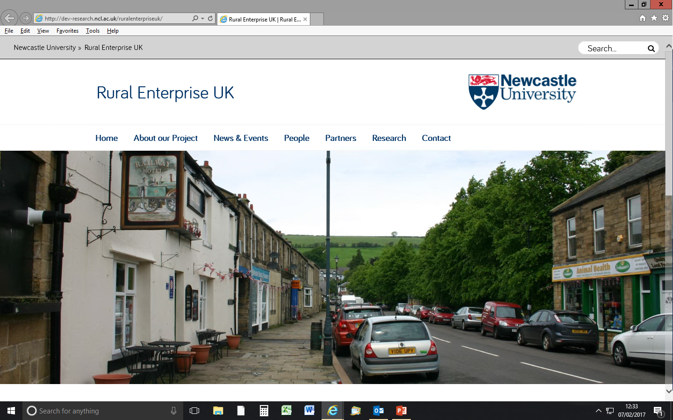

UK Industrial Strategy:
Progressing Rural Contributions
27 March 2019
#RurEntUK

Slide 2
UK Industrial Strategy:
Progressing Rural Contributions
27 March 2019 Jeremy Phillipson Centre for Rural Economy
#RurEntUK

Slide 3

Purpose of event
To consider progress and next steps in embedding rural economies into delivery of the Industrial Strategy
To take stock of how Grand Challenges and measures to boost SME Productivity are being addressed in rural areas through local industrial, economic and sector strategies
To generate key messages to inform future Strategy activities and measures of rural needs and contributions
“Cities, towns and rural areas have distinctive comparative advantages. Our national framework will only be effective if it reflects and makes the most of these economic opportunities and challenges.”

Slide 4
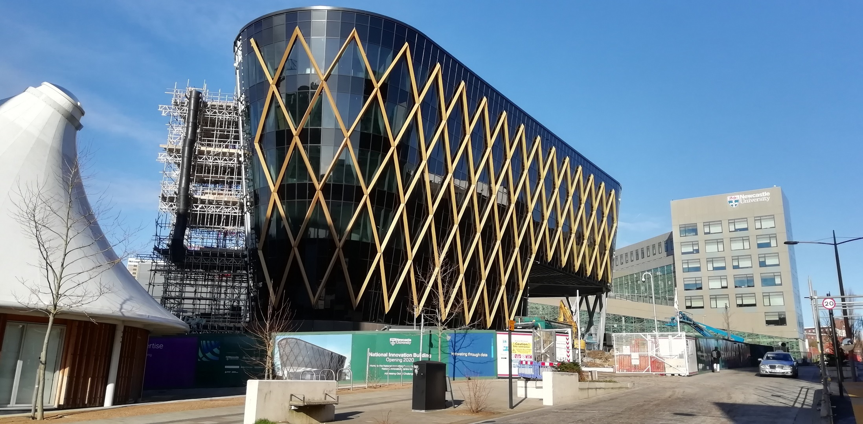
A novel gathering of expertise

Slide 5


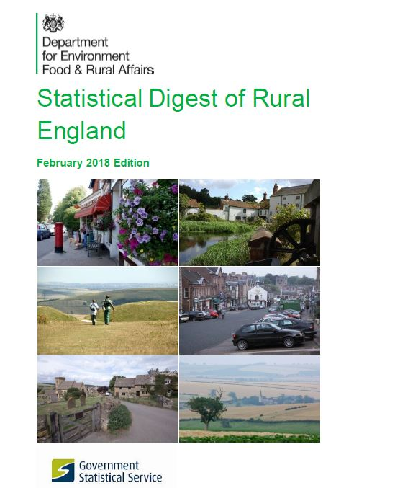
Rural Enterprise UK
https://research.ncl.ac.uk/ruralenterpriseuk/

Slide 6
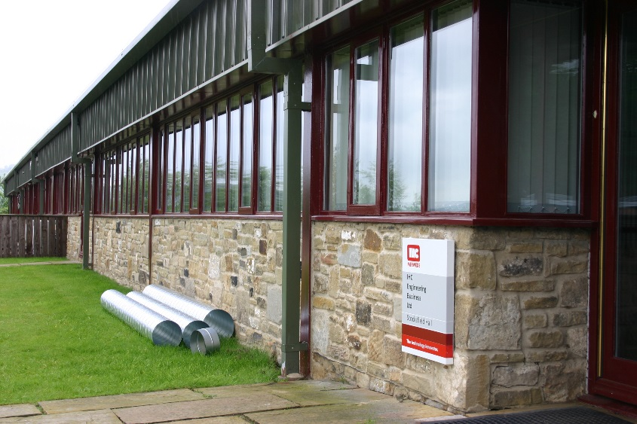
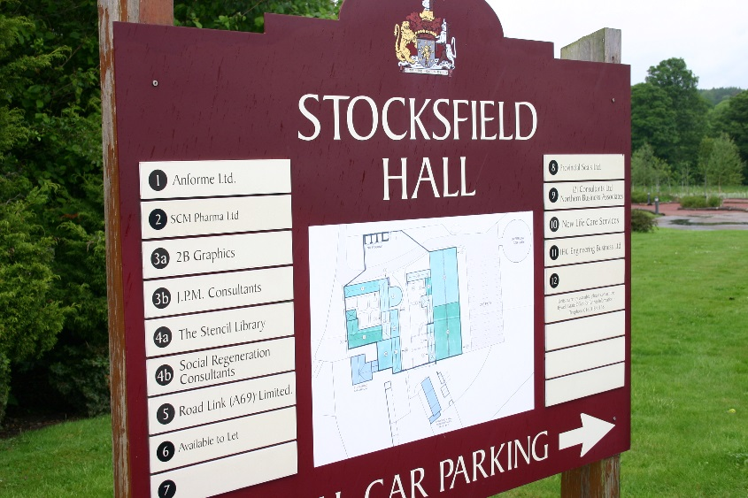
The contribution of rural economies
Rural economies are substantial in their own right and often outperform urban areas
Similar numbers plan to grow their sales and employees
Rural firms are committed to creating new products and to exporting, and show clear evidence of untapped potential

Slide 7
What do the Grand Challenges mean for rural Britain?
Rural economies can appear marginal to innovation systems and are at risk of being left behind
Rural areas at vanguard of key socio-economic trends and innovative responses
Innovation co-generated within rural places and sensitive to rural circumstances and needs

Slide 8
Enabling an enterprising countryside
Local Industrial Strategies?
“Our cities, towns and rural areas have competitive advantages that will be essential to shaping our economic future”. p.217

Slide 9
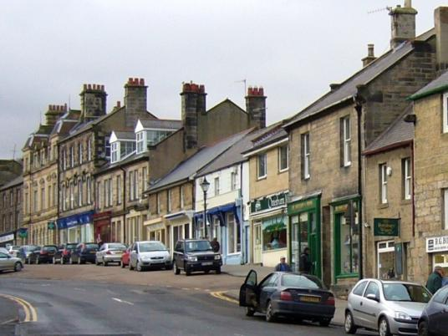
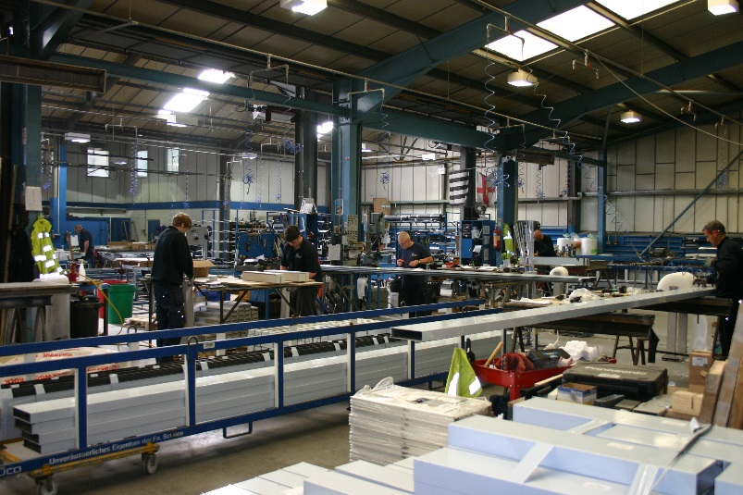
How can we ensure the rural reach and contributions of local strategies?
Local Industrial Strategies that are important expressions of diversity of rural need and opportunity
Initiatives and measures that demonstrate equitable commitment to firms operating in rural areas
Measures tailored to rural SMEs’ plans, obstacles and use of support
Locally defined sector priorities that embrace rural firms
Notes:
9

Slide 10
Structure of Day
Session 1: Introduction
Session 2: The Grand Challenges: Description, examples and opportunities
Lunch
Session 3: Localising the Industrial Strategy: Rural opportunities
Grand challenges and sector collaborations
Sub-national strategies
Foundations and productivity
Session 4: Workshop Conclusions, and what next for rural?
Networking Reception
Notes:
10

